Slide 1
House Price Prediction
Adith Sukumar

Slide 2
Dataset
Based on the Kaggle dataset “House Prices: Advanced Regression Techniques”
Need to predict SalePrice based on given 80 features using regression models.
Dependent feature will be SalePrice and we will designate it as Y
Independent features will be LotArea, No of Garages and so on and will be designated as x1… x80

Slide 3
Project Flow
Data Cleaning
Data Manipulation
Machine Learning Techniques
Data Exploration

Slide 4
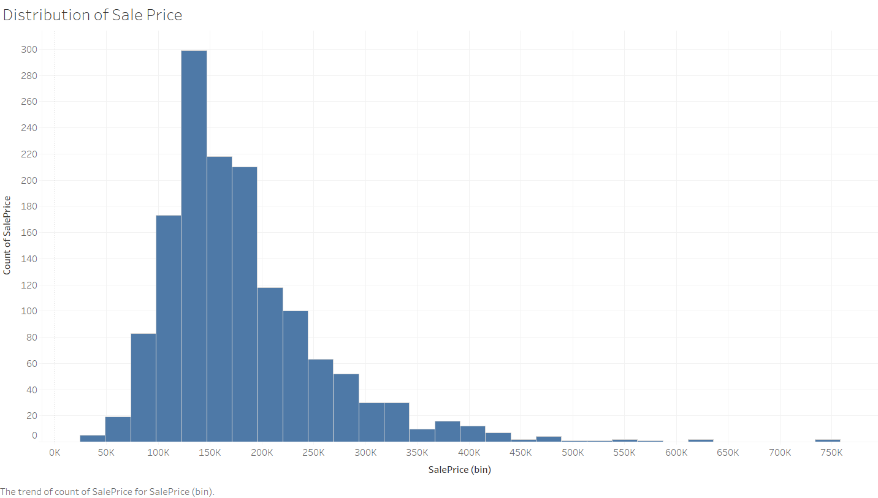
Data Exploration for SalePrice
SalePrice is rightly skewed and has high kurtosis value

Slide 5
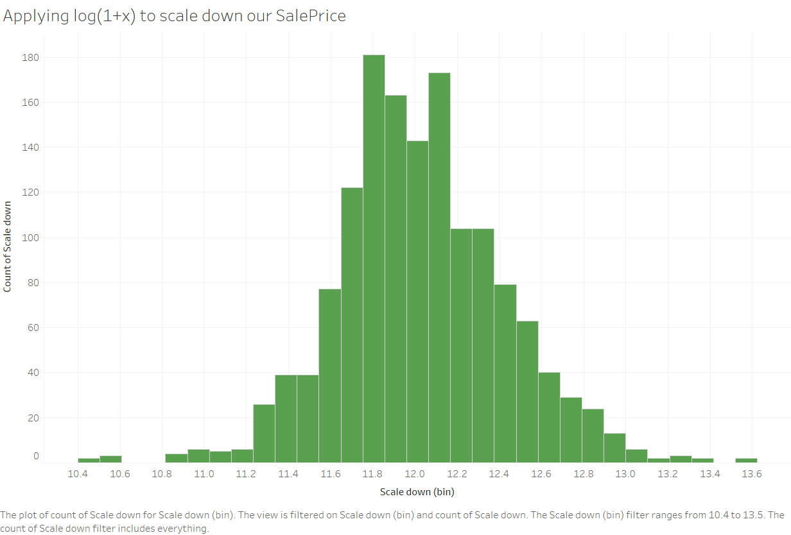

Slide 6
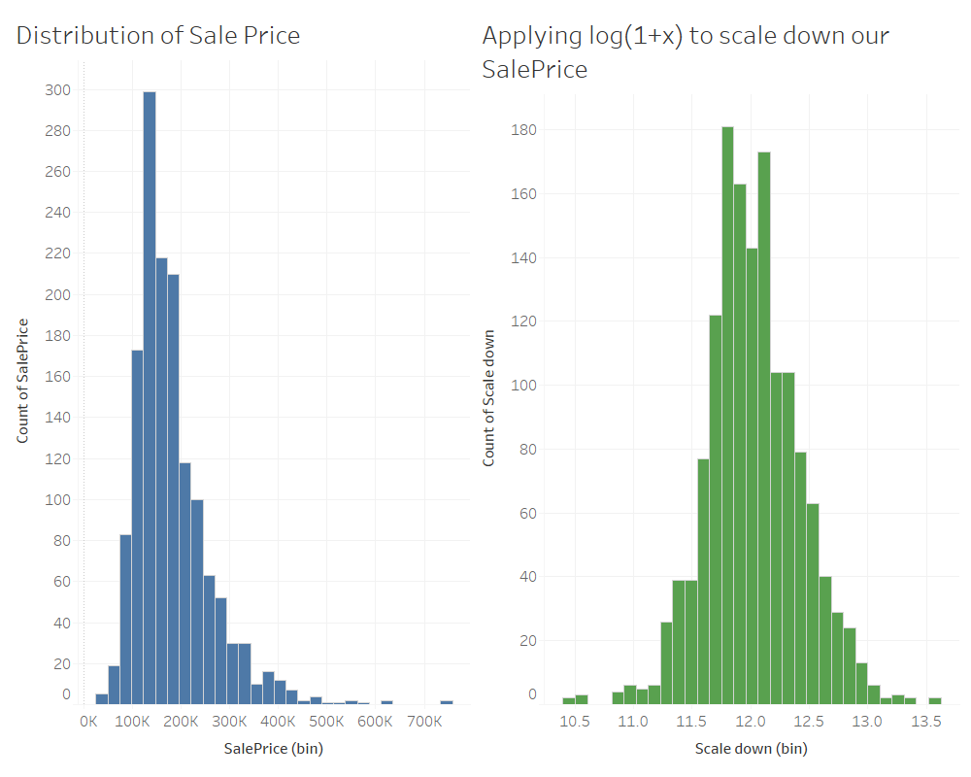
Outcome of applying log transformation to SalePrice

Slide 7
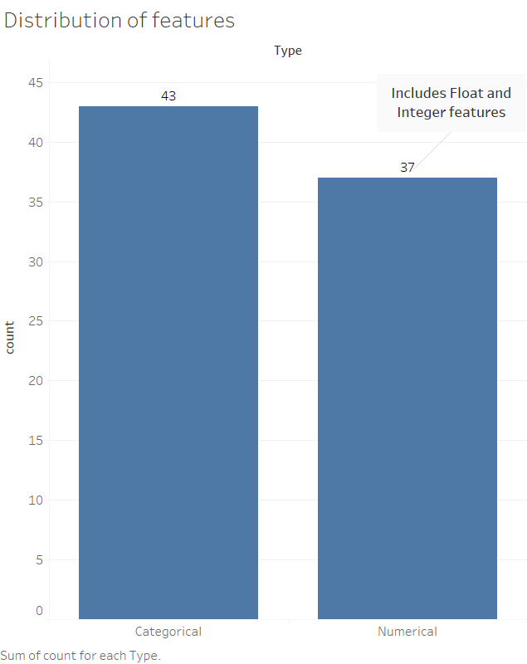
Data Exploration of independent features

Slide 8
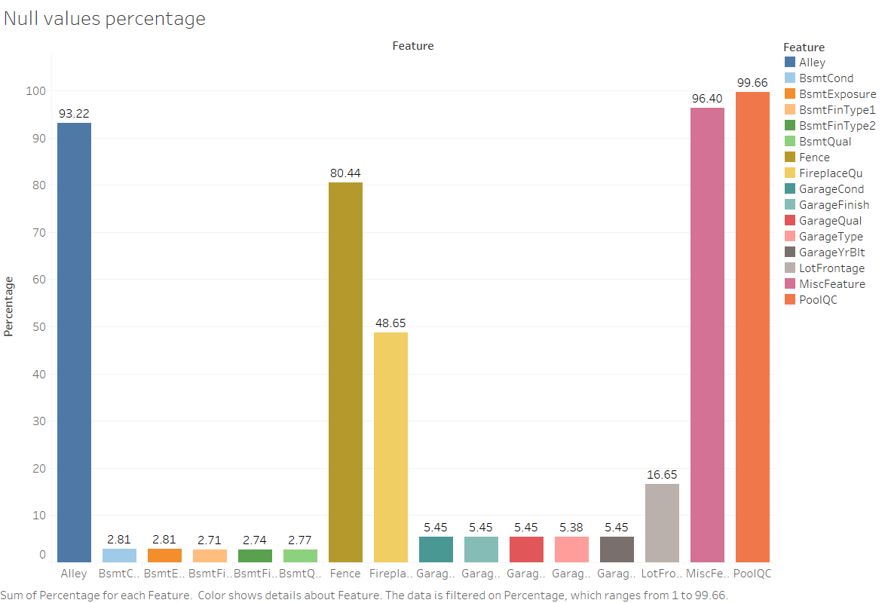
Data Cleaning by removing features with Null values more than 90%

Slide 9
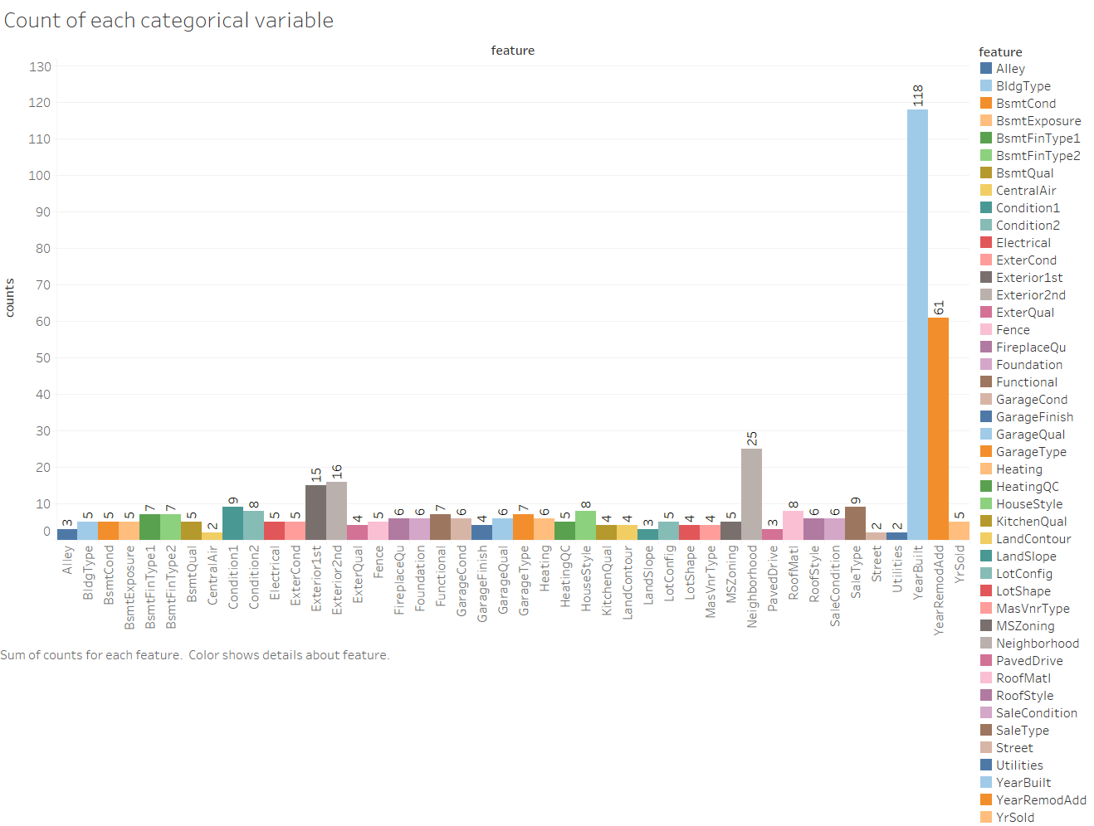
Removing categorical features having more than 100 features

Slide 10
Summary of Data wrangling methods
Used log transformation for SalePrice to reduce the skewness.
Deleted columns having NULL value percentage of more than 90%.
Used boxcox1p transformation on numerical features to reduce the skewness of dependent variables
Removed the YearBuilt features to reduce complexity of the algorithm as it had too many features.
Removed id column as it would not assist in prediction.

Slide 11
Machine Learning using Regression
Hyper parameterization
Algorithms
Linear Regression
Gradient Boosting Regressor
Random Forest Regressor
AdaBoost Regressor
XGB Regressor
Support Vector Regressor
Blended

Slide 12
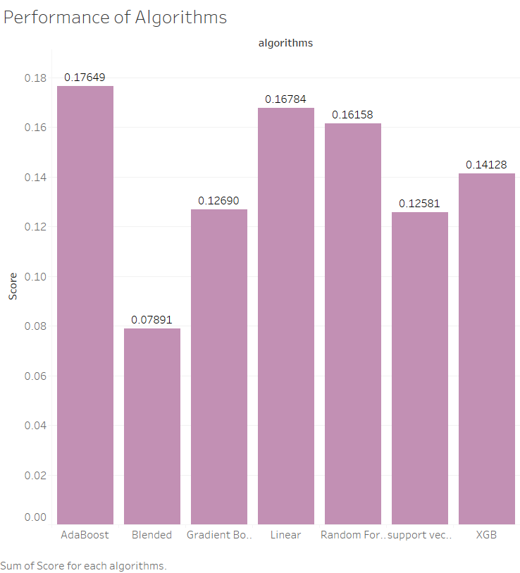
on Cross validation Test scores

Slide 13
Future Extensions
Test set performance: 0.12
Need to see more relationship between features to see best fit.
Introducing more Regression algorithms like Lasso and Ridge

Slide 14
Tools used
Python
Jupyter Notebook
Libraries: NumPy, SciPy, seaborn, matplotlib
Visualization: Tableau, PowerPoint
Kaggle link: https://www.kaggle.com/c/house-prices-advanced-regression-techniques/

